Slide 1
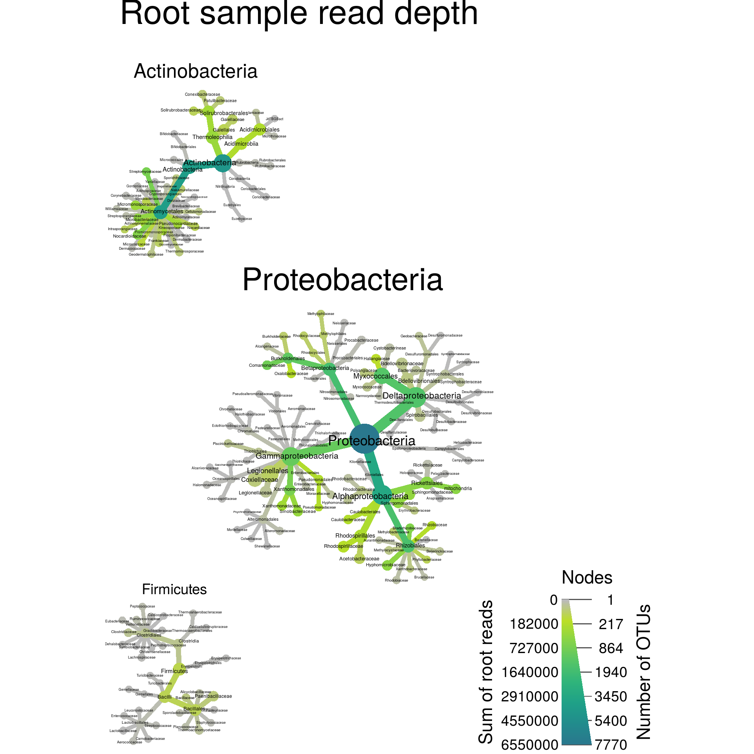
Introduction to metacoder
Ella Thoen
21.04.23

Slide 2
How to visiualize the taxonomic data from your metabarcoding study?

Slide 3
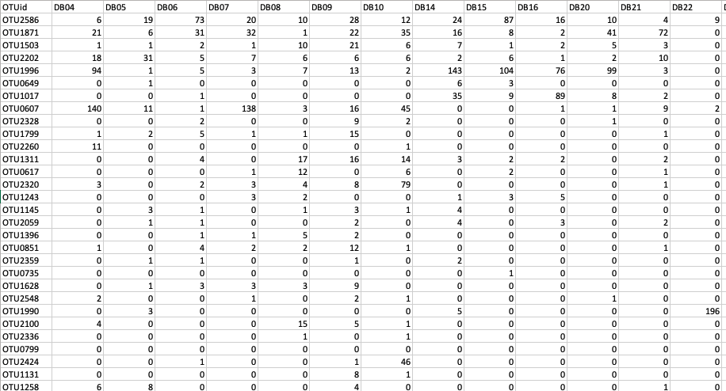
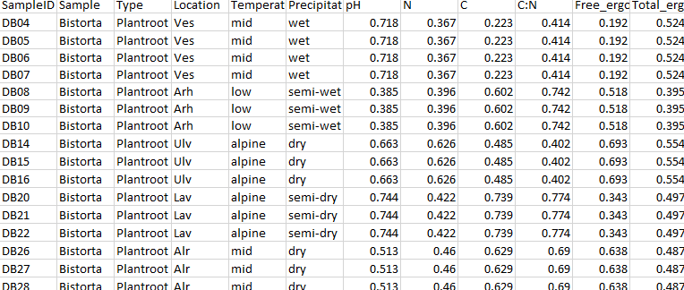
OTU table

Slide 4
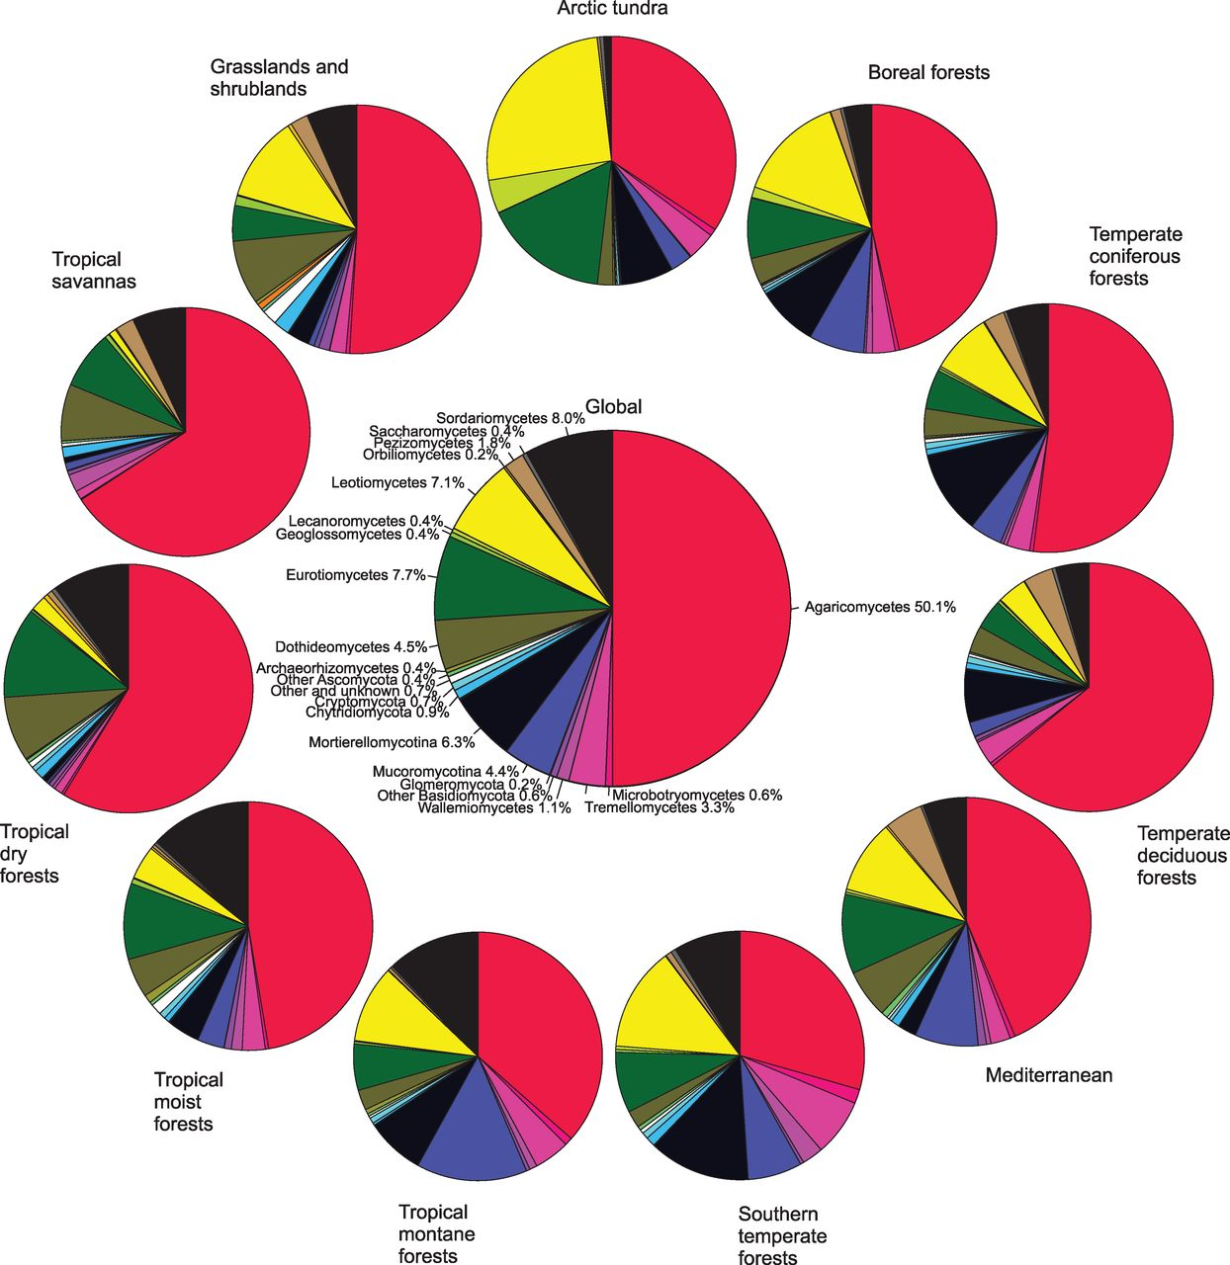
Pie chart?
Tedersoo et al 2014

Slide 5
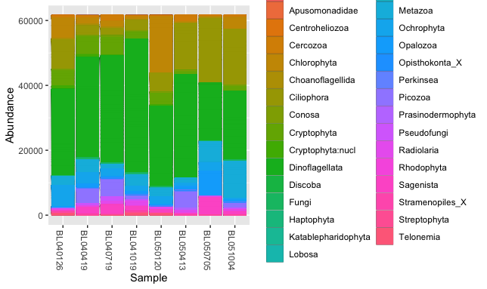
Stacked bar chart?

Slide 6
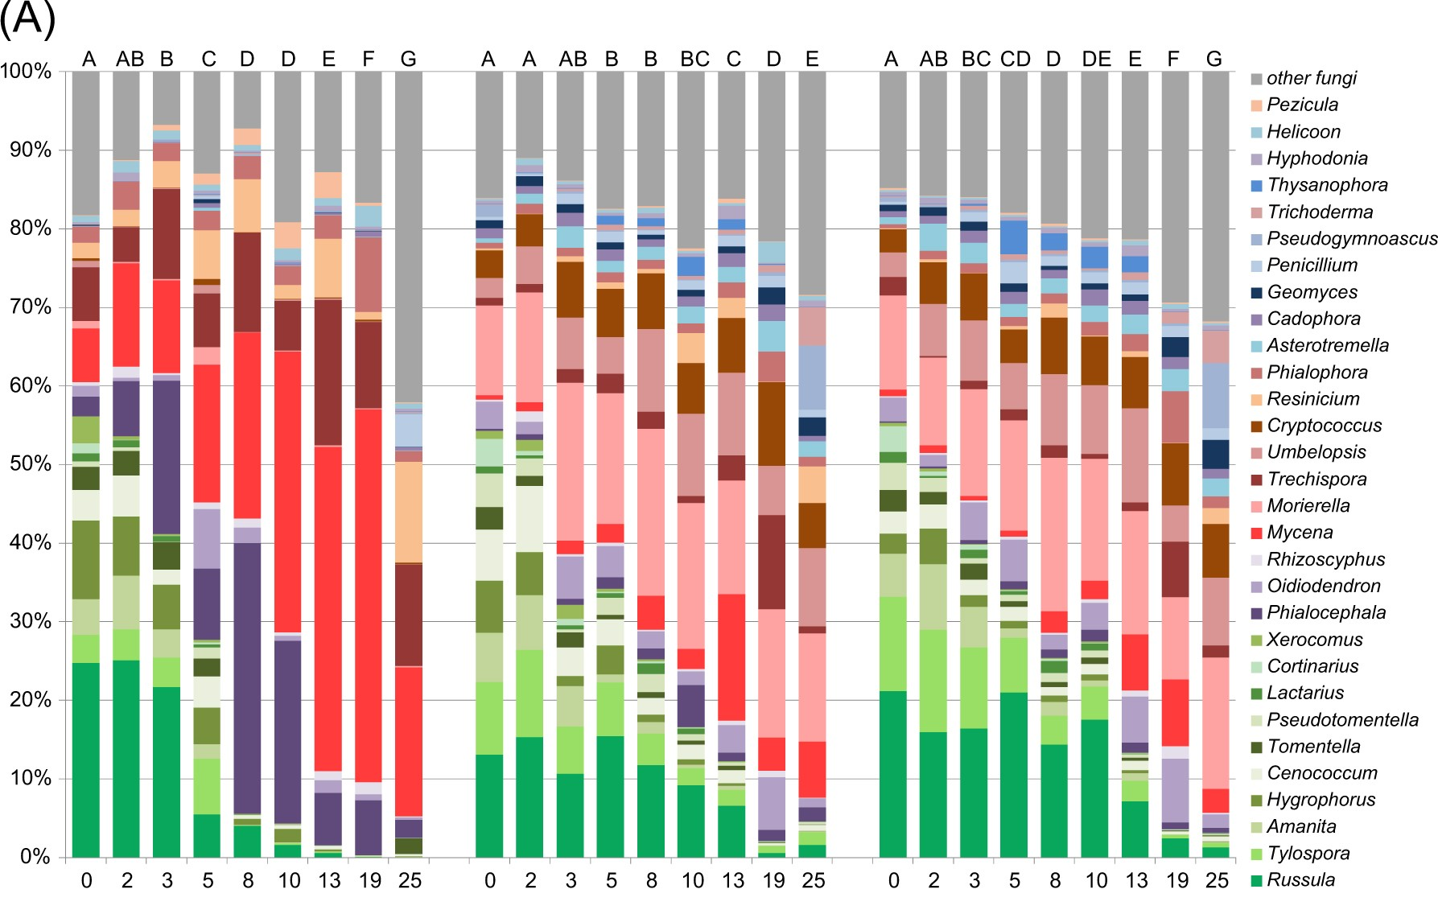
Stacked bar chart?
Kohout et al 2018

Slide 7
Heat trees?

Slide 8
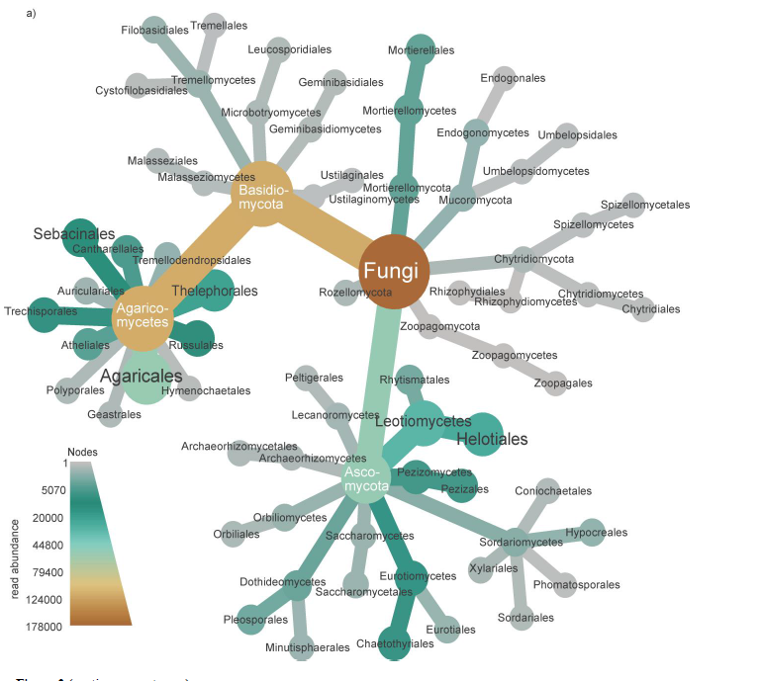
Heat trees with metacoder
Metacoder uses the phylogenetic backbone of your taxonomic data to construct heat trees
=NOT phylogenetic trees!
Depict statistics for every taxon in a taxonomy using color and size
Nodes (circles) scaled and colored according to read abundance
Edges (branches) scaled and colored by read abundance

Slide 9
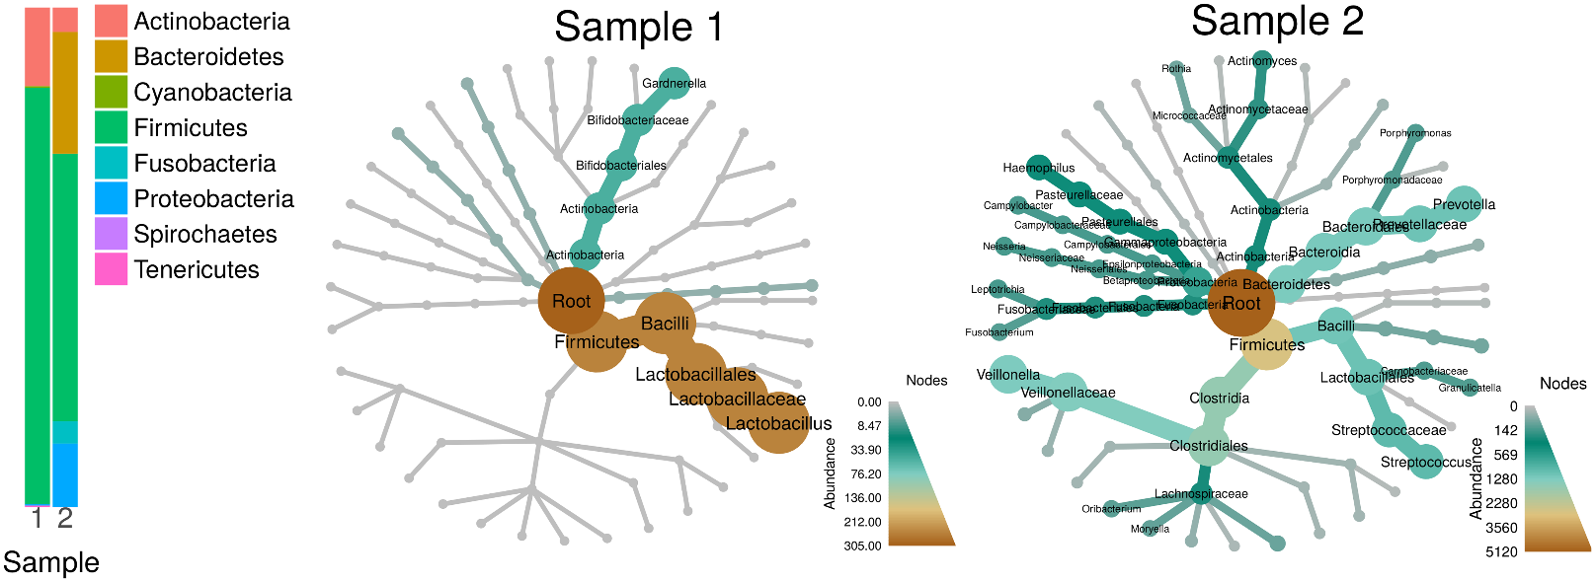
Barcharts vs Heat trees with metacoder
Fig 2. from Foster et al 2017
Heat trees allow for a better understanding of community structure than stacked bar charts

Slide 10
Heat trees with metacoder
Fig 2. from Foster et al 2017
Heat trees allow for a better understanding of community structure than stacked bar charts

Slide 11

An R package for parsing, plotting and manipulating large taxonomic datasets

Slide 12
What can you do with metacoder?
Summing read counts/relative abundance per taxon
Converting counts to proportions and rarefaction of counts using vegan
Comparing the abundance of groups of samples per taxon
Combining data for groups of samples
Simulated PCR (primer specificity and coverage of taxonomic groups)
Converting common microbiome formats for data and reference databases into the objects defined by the taxa package.
Converting to and from the phyloseq format and the taxa format
But most important: data visualization with heat trees!

Slide 13
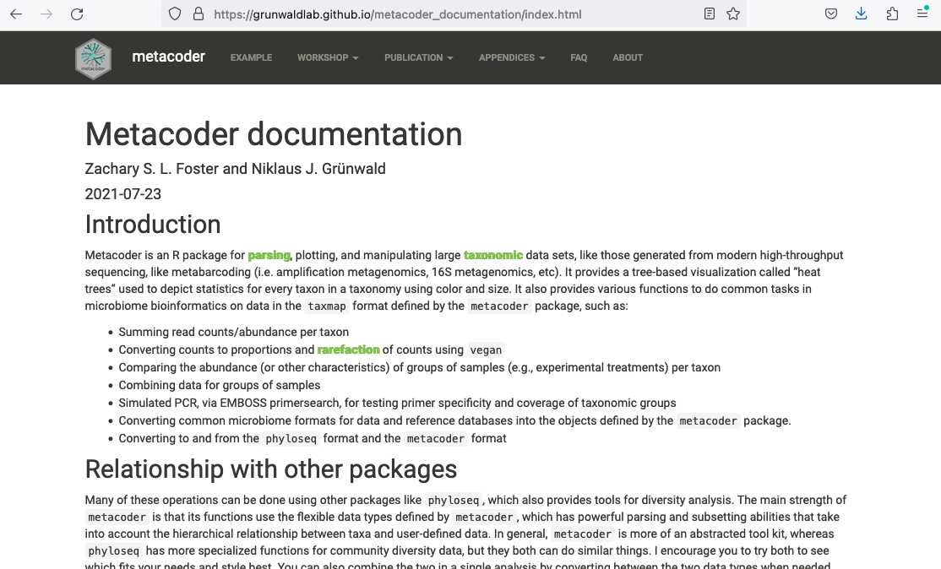
https://grunwaldlab.github.io/metacoder_documentation/index.html

Slide 14
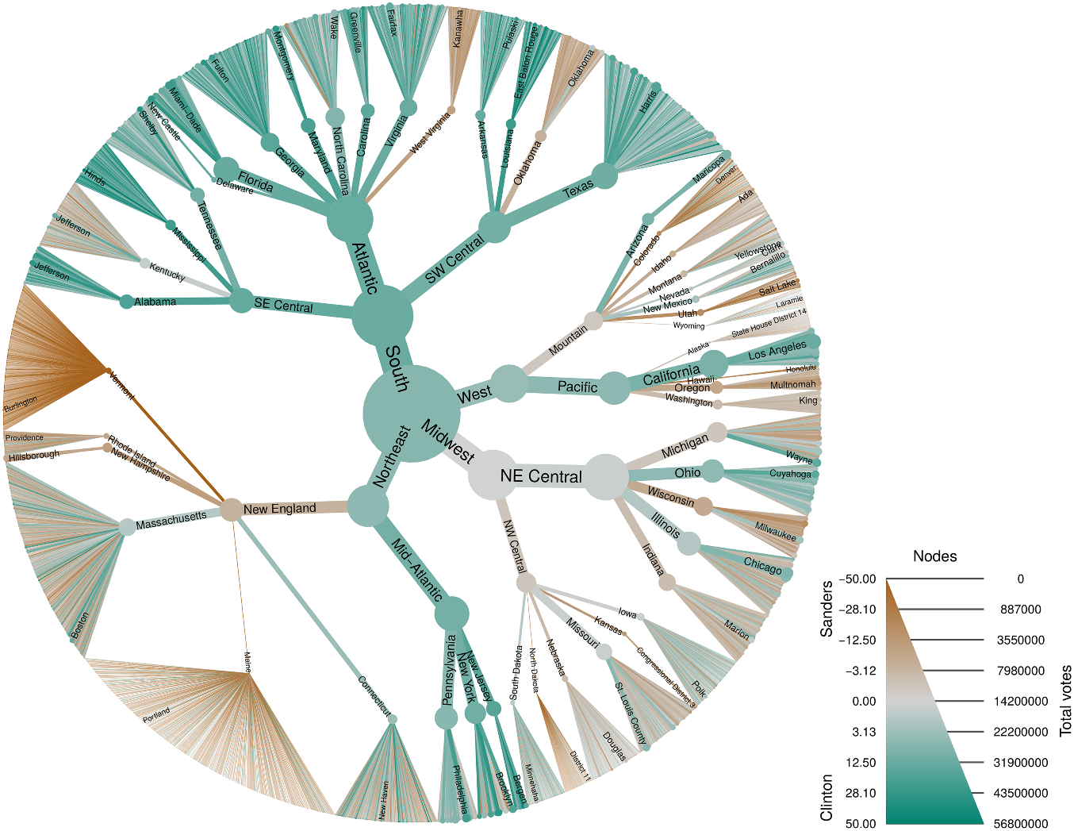
metacoder can be used with any type of data that can be organized hierarchically
Fig. 6. Foster et al 2017

Slide 15
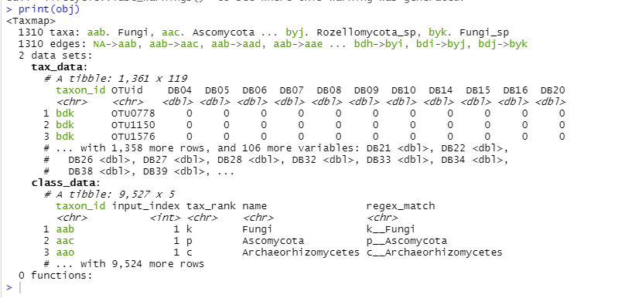
Relationship with other packages
metacoder can do similar things to e.g. phyloseq
Uses the flexible data types defined by taxa
Plotting is using ggplot2- graphics
Your data is organized in tibbles
(Tidyverse)
→ easy to use in other analyses

Slide 16
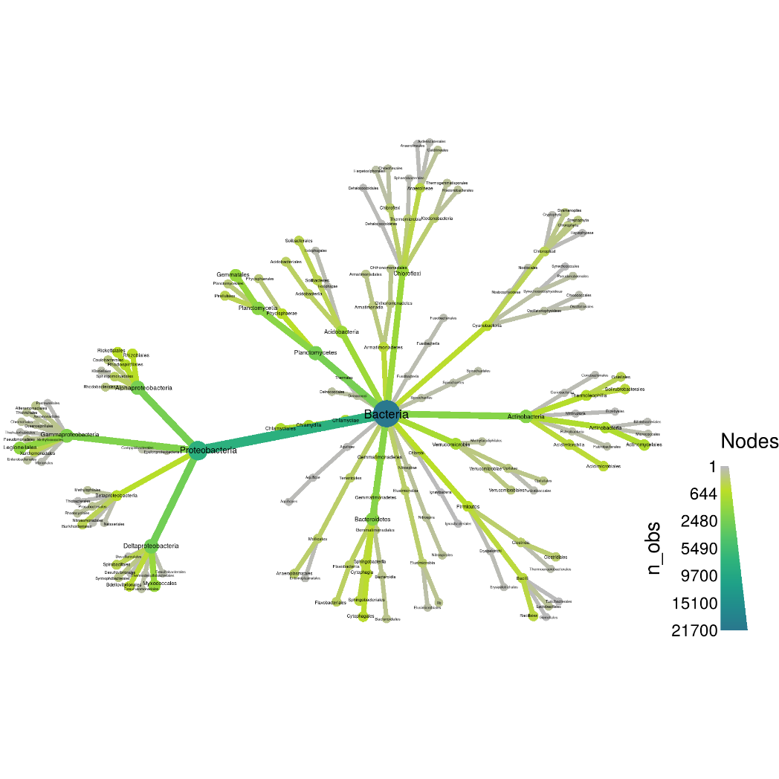
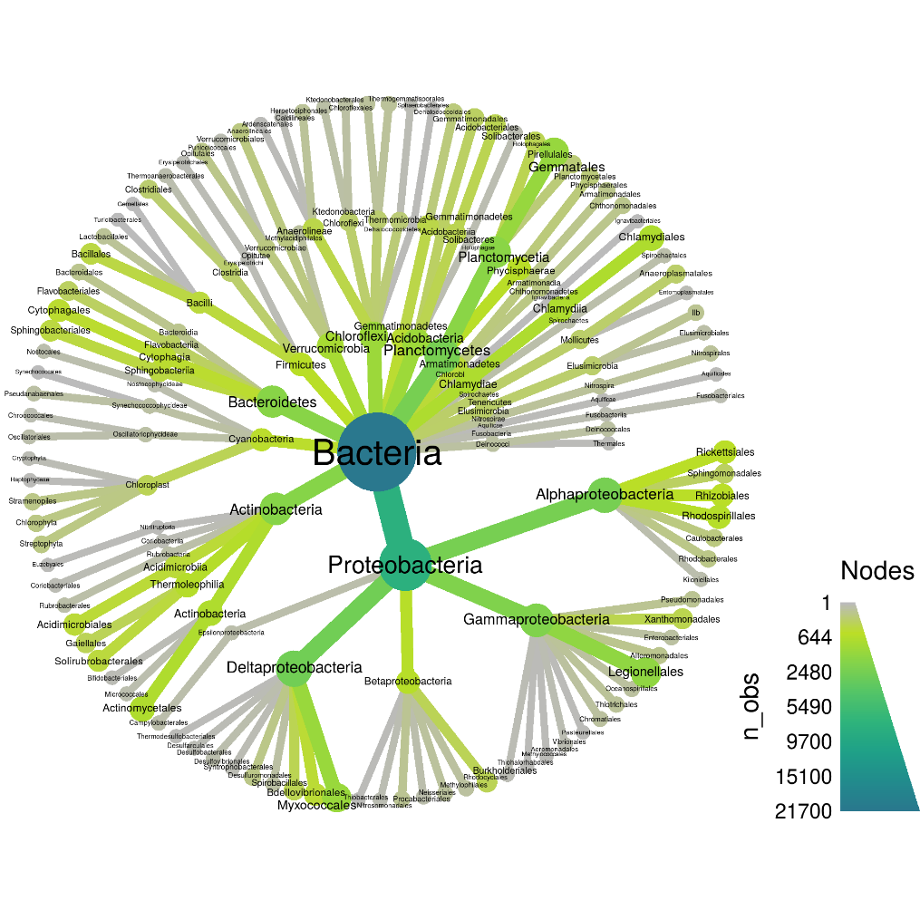
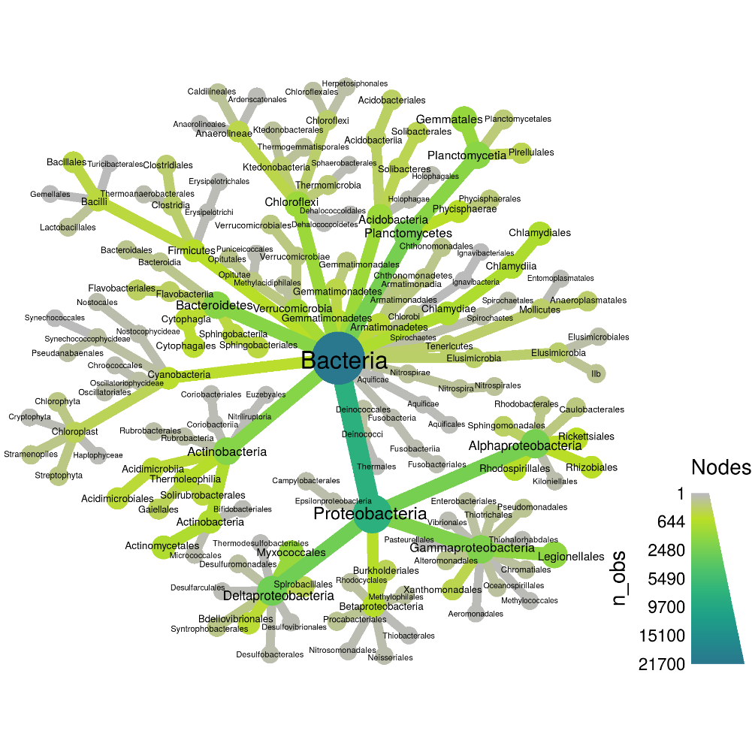
Standard heat tree heat_tree()
fruchterman-reingold
reingold-tilford (the default)
https://grunwaldlab.github.io/metacoder_documentation/index.htm
Combination of “reingold-tilford” and “davidson-harel”

Slide 17
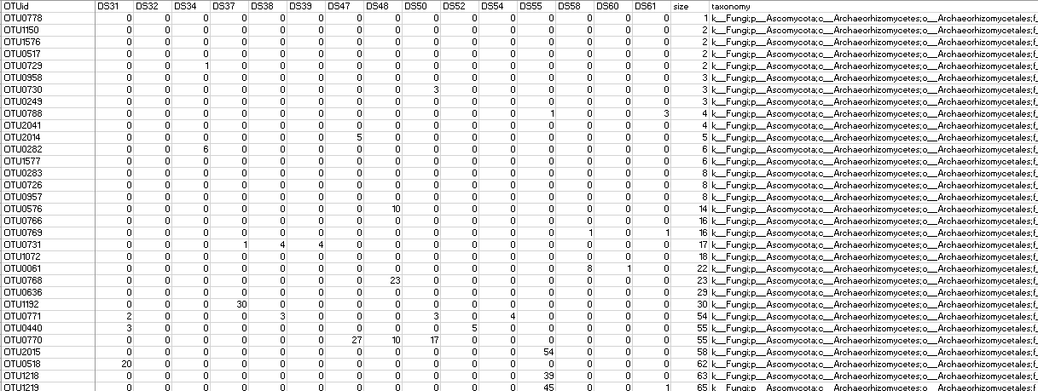
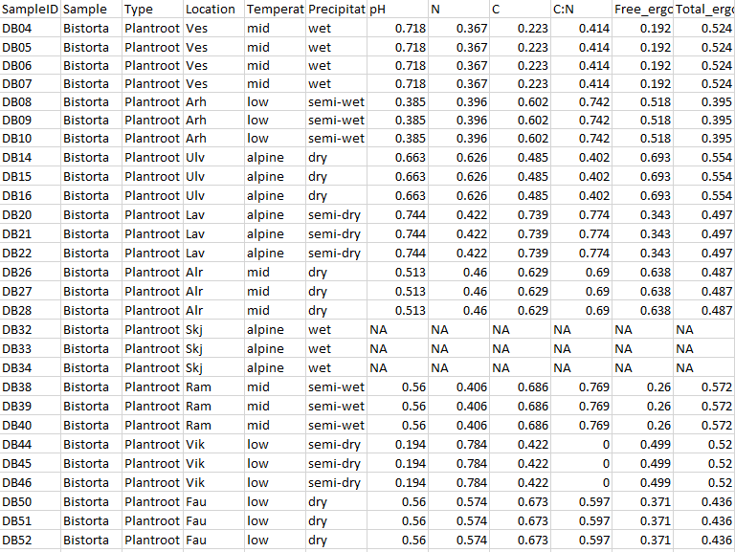
Visulaization of «standard» metabarcoding datasets
OTU table
Taxonomy for each OTU
(Sample metadata)

Slide 18
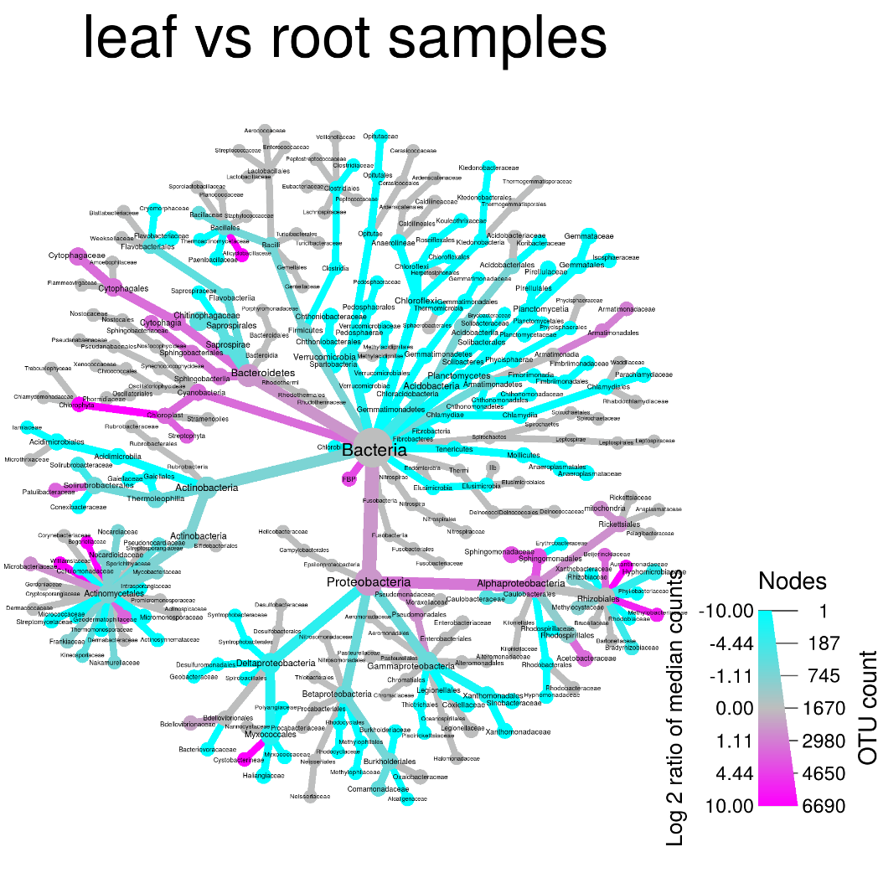
Comparing two treatments
compare_groups()
https://grunwaldlab.github.io/metacoder_documentation/index.htm

Slide 19
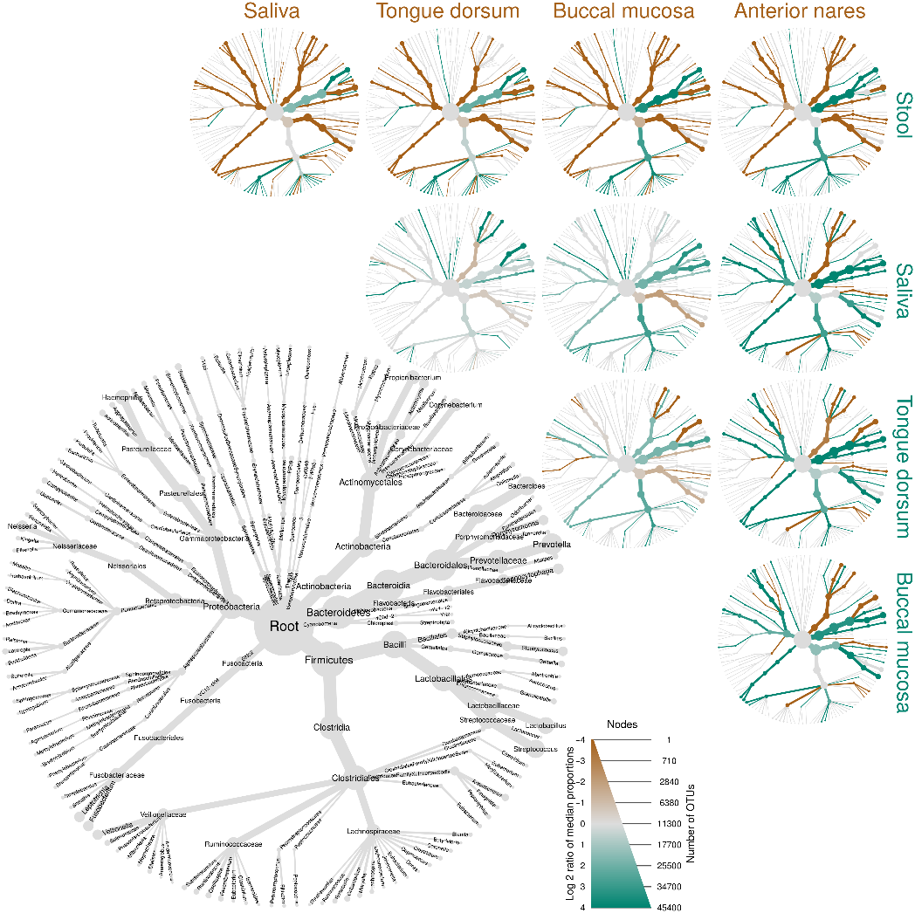
Comparing three or more treatments
= heat tree matrix
https://grunwaldlab.github.io/metacoder_documentation/index.htm

Slide 20
Case study (for R)
Three sample types collected over a climate gradient in seminatural grasslands in West Norway; soil samples and two different plant roots
The dataset has been reduced and modified – we will only look at how to make heat trees and compare differences in sample type
Soil
«All» fungi
Potentilla erecta
AM or non-mycorrhizal fungi
Bistorta vivipara
EcM fungi

Slide 21
Data format for this metacoder script
OTU data with samples as columns and OTUs as rows
Taxonomy (or other hierarchical information) with a “denominator” for each level, here included as a single column; taxonomy:
k__Fungi;p__Basidiomycota;c__Agaricomycetes;o__Agaricales;f__Inocybaceae;g__Inocybe;s__Inocybe_castanea
Sample data/metadata organized with samples as rows and variables as columns

Slide 22
The dataset
Three files:
The script called: IntroMetacoder.R
The OTU table including taxonomic assignment (rarotutable_small.txt)
Sample data containing information for each sample (sampledata.txt)
These are available at the github pages if you wish to try this yourself!

